Slide 1

COP 6731: Theory and Implementation of Database Systems
File and Index Structures

Slide 2
Outline
Goal:
Learning storage and access methods.
Physical Level
Block, Blocking Factor, Record
File Organization
Hashing Techniques

Slide 3
Physical Database Design
The database design process is divided into three main phases: (1) conceptual, (2) logical, and (3) physical database design.

Slide 4
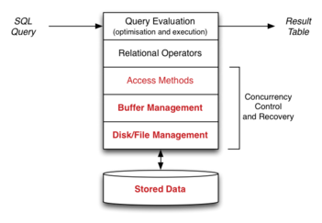
Physical Database Design

Slide 5
Physical database file structure
Databases are stored physically as files of records.
Cache Memory
Main Memory
Flash Memory
Magnetic disk
Optical Drives
Magnetic tapes
Storage device hierarchy

Slide 6
Data on External Storage
Disks can retrieve random pages at a fixed cost.
But reading several consecutive pages is much cheaper than reading them in random order
Tapes: Can only read pages in sequence
Cheaper than disks; used for archival storage
File organization: Method of arranging a file of records on external storage.
Record id (rid) is used to identify the physical location of the record.
Indexes are data structures that allow us to find the ids of records with the index search key.
Architecture: Buffer manager brings pages from physical disk to main memory (i.e., buffer cache) as needed. File and index layers make calls to the buffer manager.

Slide 7
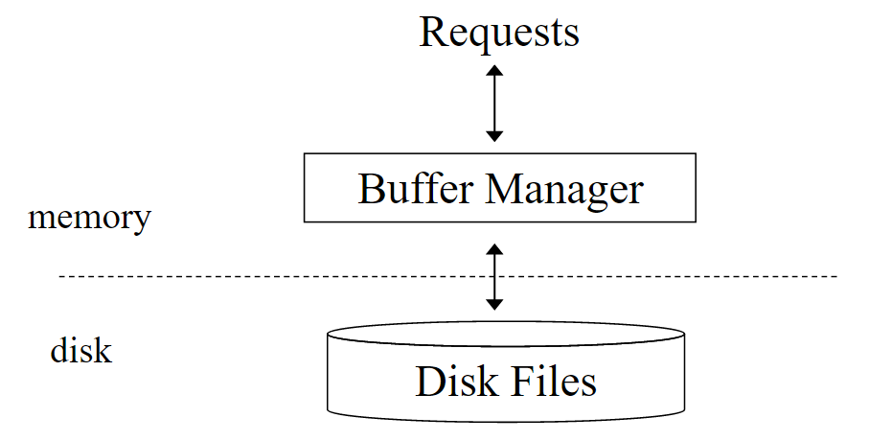
Buffer cache and Disk Files

Slide 8
Alternative File Organizations
Many alternatives exist, each ideal for some situations, and not so good in others:
Heap (random order) files: Suitable when typical access is a file scan retrieving all records.
Sorted Files: Best if records must be retrieved in some order, or only a ‘range’ of records is needed.
Indexes: Data structures to organize records via trees or hashing.
Like sorted files, they speed up searches for a subset of records, based on values in certain (“search key”) fields
Updates are much faster than in sorted files.

Slide 9
Disks and Files
DBMS stores information on (“hard”) disks.
This has major implications for DBMS design!
READ: transfer data from disk to main memory (RAM).
WRITE: transfer data from main memory to disk.
Both are high-cost operations, relative to in-memory operations, so must be planned carefully!

Slide 10
Why Not Store Everything in Main Memory?
Costs too much
Main memory is volatile.
Typical storage hierarchy:
Main memory (RAM) for currently used data.
Disk for the main database (secondary storage).
Tapes for archiving older versions of the data (tertiary storage).

Slide 11
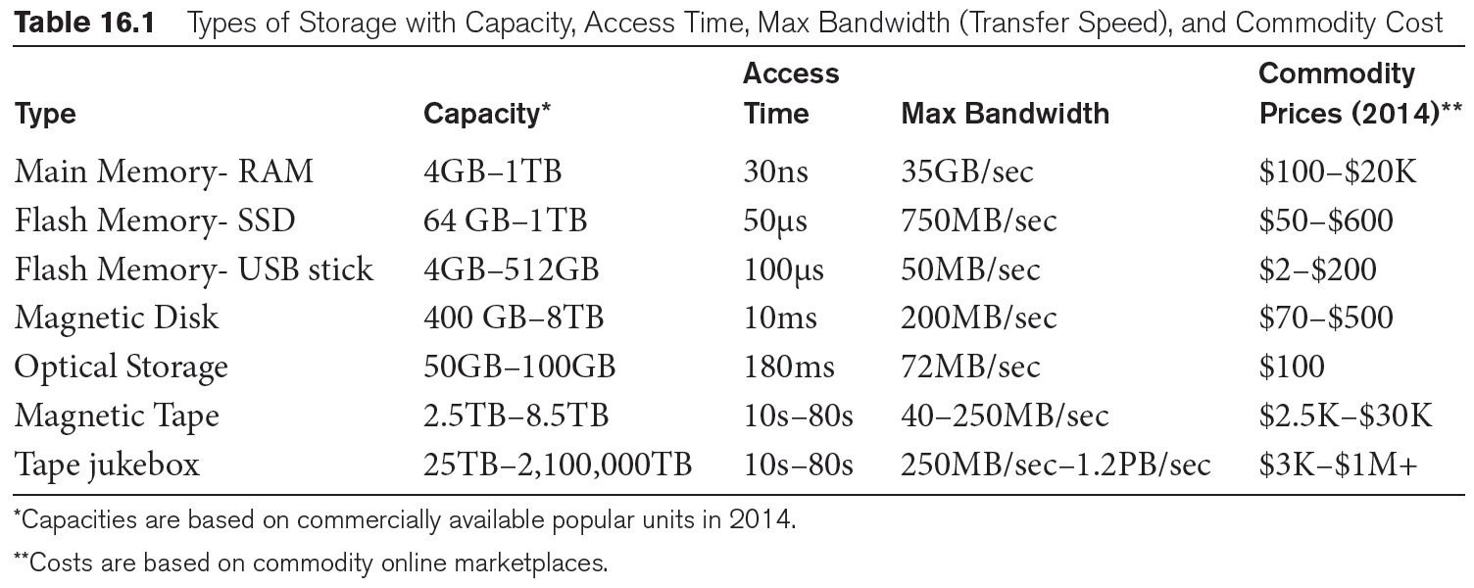
Memory vs. Disk
DBMS stores data on the magnetic disk and fetches data into the main memory for processing.
Disk access is the main bottleneck.

Slide 12
Disk
Secondary storage device of choice.
Main advantage over tapes: random access vs. sequential.
Data is stored and retrieved in units called disk blocks or pages.
The time to retrieve a disk page varies depending upon the location on the disk.
Therefore, the relative placement of pages on disk has a major impact on DBMS performance!

Slide 13
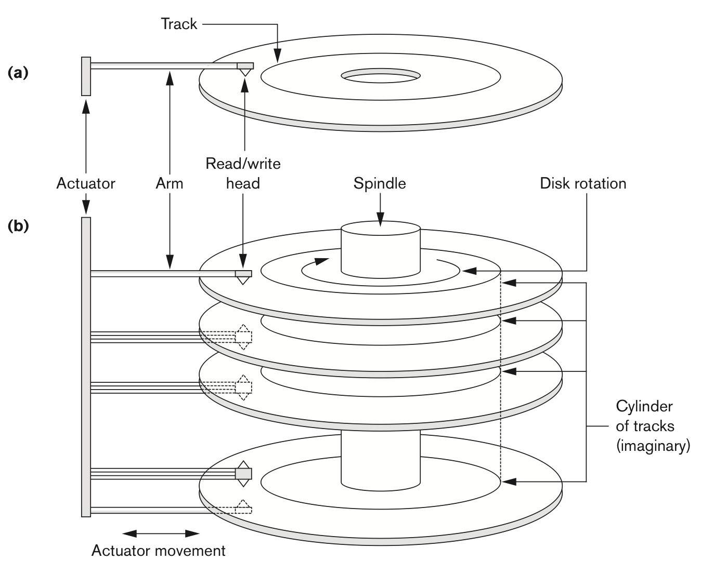
Moving head disk mechanism

Slide 14
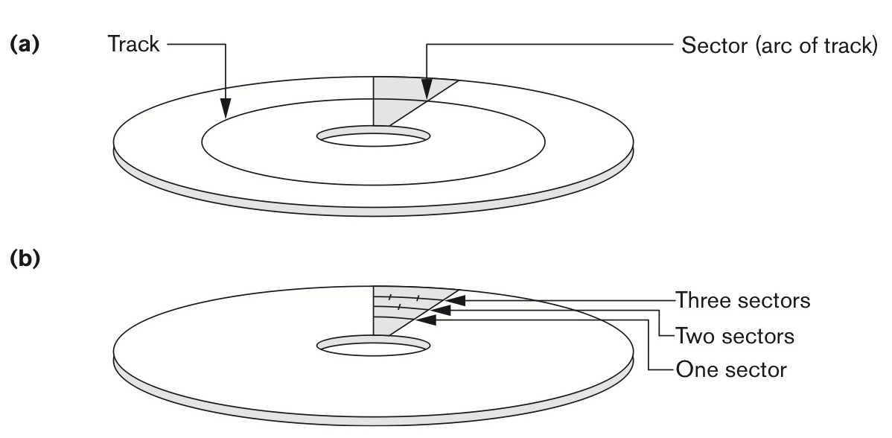
Track, Sector, and Disk Block
The disk surface is divided into tracks, which are subdivided into sectors.
The track is divided into equal-sized disk blocks (or pages).
Transfer of data between main memory and disk takes place in units of disk blocks.

Slide 15
Accessing a Disk Page
Time to access (read/write) a disk block:
seek time (moving the read/write head from one track to another)
Rotational delay (waiting for the block to rotate under the head)
transfer time (moving data to/from disk surface)
Seek time and rotational delay dominate.
Key to lower I/O cost: reduce seek/rotation delays! Hardware vs. software solutions?
‘Blocks in a file should be arranged sequentially on disk (by ‘next’), to minimize seek and rotational delay.

Slide 16
Buffer Management in a DBMS
Data must be in Main memory for DBMS to operate it.
Table of <frame#, pageid> pairs is maintained.
Buffer Pool
Page (or block)
pin count
dirty bit
Main Memory
choice of frame dictated
by replacement policy
Disk

Slide 17
When a Page is Requested ...
If the requested page is not in the pool:
Choose a frame for replacement
If the frame is dirty, write it to the disk
Read requested page into the chosen frame
Pin the page and return its address.
If we predict the requests (e.g., sequential scans), we can pre-fetch several pages at a time!

Slide 18
More on Buffer Management
Page in the pool may be requested many times. A pin count is used for tracking the number of requestors currently using the page.
If the pin count of a page is zero, then the page is a candidate for replacement.
A dirty bit is used for indicating whether the corresponding block of memory has been modified.
Concurrency Control & Recovery may entail additional I/O when a frame is chosen for replacement (e.g., Write-Ahead Log)

Slide 19
Buffer Replacement Policy
Frame is chosen for replacement by a replacement policy:
Least-recently-used (LRU), Clock, MRU etc.
Policy can have big impact on # of I/O’s; depends on the access pattern.
Sequential flooding: Nasty situation caused by LRU + repeated sequential scans.
# buffer frames < # pages in file means each page request causes an I/O. Most-Recently Used (MRU) much better in this situation (but not in all situations, of course).

Slide 20
DBMS vs. OS File System
OS does disk space & buffer management: why not let OS manage these tasks?
Differences in OS support: portability issues
Buffer management in DBMS requires an ability to:
Pin a page in the buffer pool, force a page to disk (important for implementing Concurrency Control & recovery),
Adjust replacement policy, and pre-fetch pages based on access patterns in typical DB operations.

Slide 21
Blocking Factor
Data must be in the Main memory for DBMS to operate it.
Disk
disk block
Record
Record
Record
Record
Record
Record
Given block size B and record size R,
Blocking Factor (bfr) = floor ( B / R ).
Therefore, unused space in each block is B - ( bfr * R ).

Slide 22
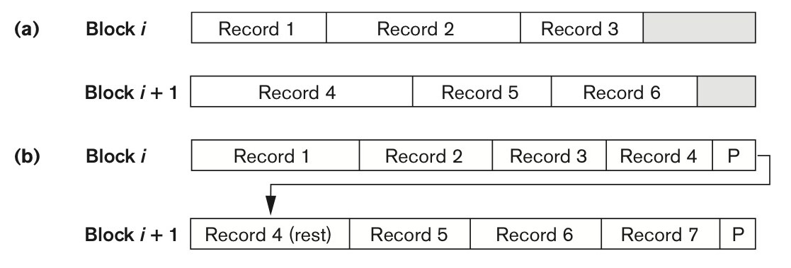
Block and Record
Types of record organization. (a) Unspanned. (b) Spanned.
Information about field types same for all records in a file; stored in system catalogs.
Finding the i’th field (or column) requires a scan of the record.

Slide 23
Record Formats: Variable Length
Two alternative formats (# fields is fixed):
F1 F2 F3 F4
4
$
$
$
$
Fields Delimited by Special Symbols
Field
Count
F1 F2 F3 F4
Array of Field Offsets
Second offers direct access to the i’th field, efficient storage of NULL values; small directory overhead.

Slide 24
Operations on Pages (or Blocks)
Record
Record
Record
Record
Record
Record
Operations
Find
Delete
Modify
Insert
Buffer Pool
Page
pin count
dirty bit
Main Memory
Disk

Slide 25
Files of Records
FILE: A collection of pages (or blocks), each page (or block) containing a collection of records. Must support:
insert/delete/modify record
read a particular record (specified using record-id)
scan all records (possibly with some conditions on the records to be retrieved)

Slide 26
Unordered (Heap) Files
Simplest file structure contains records in no specific order.
As the file grows and shrinks, disk pages are allocated and de-allocated.
To support record level operations, we must:
keep track of the pages in a file
keep track of free space on pages
keep track of the records on a page
There are many alternatives for keeping track of this.

Slide 27
Heap File Implemented as a List
Data
Page
Data
Page
Data
Page
Full Pages
Header
Page
Data
Page
Data
Page
Data
Page
Pages with
Free Space
The header page-id and Heap file name must be stored someplace.
Each page contains 2 ‘pointers’ plus data.

Slide 28
Heap File Using a Page Directory
Data
Page 1
Header
Page
Data
Page 2
Data
Page N
DIRECTORY
The entry for a page can include the number of free bytes on the page.
The directory is a collection of pages; linked list implementation is just one alternative.

Slide 29
System Catalogs
For each index:
structure (e.g., B+ tree) and search key fields (or columns)
For each relation:
name, file name, file structure (e.g., Heap file)
attribute name and type, for each attribute
index name, for each index
integrity constraints
For each view:
view name and definition
Statistics, authorization, buffer pool size, etc.
Catalogs are themselves stored as relations!

Slide 30
System Catalogs
Attr_Cat(attr_name, rel_name, type, position)

Slide 31
RAID
Disk Array: Arrangement of several disks that gives abstraction of a single and large disk.
Goals: Increase performance and reliability.
Two main techniques:
Data striping: data is partitioned; the size of a partition is called the striping unit. Partitions are distributed over several disks.
Redundancy: redundant information allows the reconstruction of data if a disk fails.

Slide 32
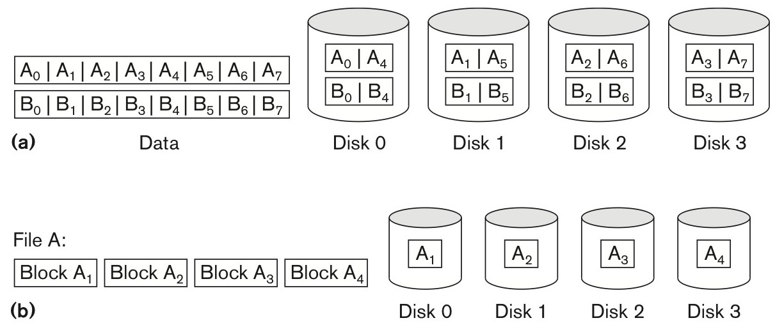
Parallelizing Disk Access
RAID (Redundant Arrays of Inexpensive Disks)

Slide 33
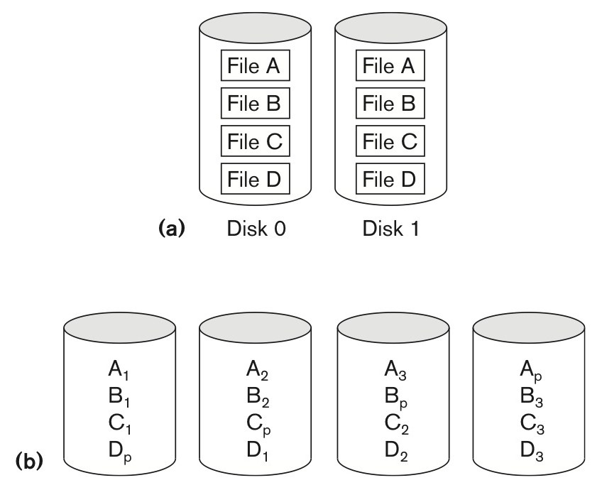
RAID

Slide 34
Record Organization
Files of Unordered Records (Heap File)
3 | 4 | 2 | 5 | 1 | 6 | 7 | 9 | 10 | 8
Given block size B
FIND
INSERT
DELETE

Slide 35
Record Organization
Files of Ordered Records (Sorted File)
1 | 2 | 3 | 4 | 5 | 6 | 7 | 8 | 9 | 10
Given block size B
FIND
INSERT
DELETE

Slide 36
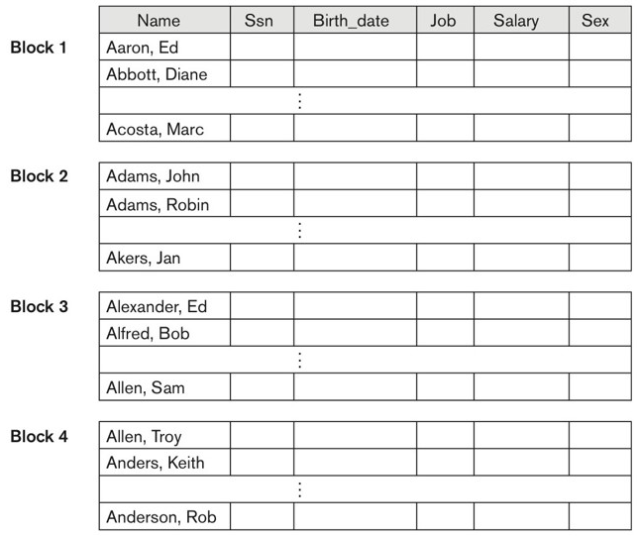
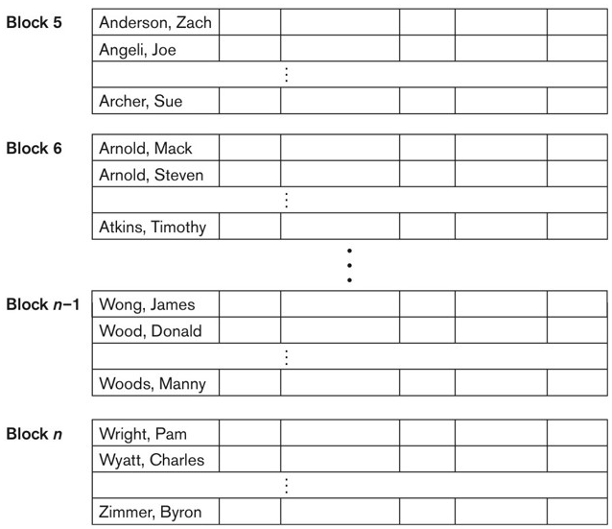
Record Organization
Files of Ordered Records (Sorted File)

Slide 37
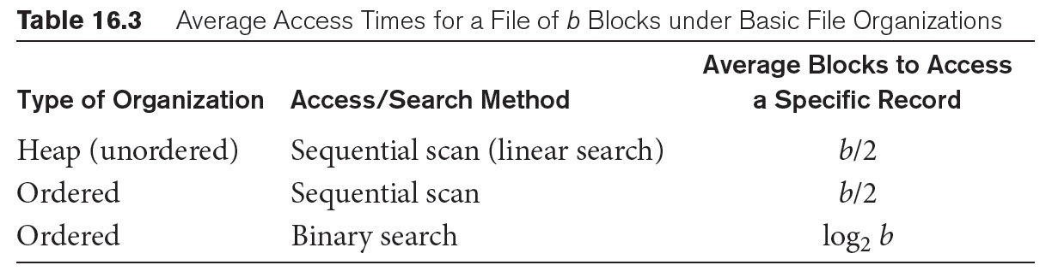
Cost Model

Slide 38
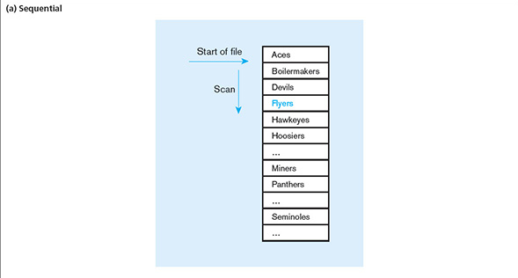
(a) Sequential

Slide 39
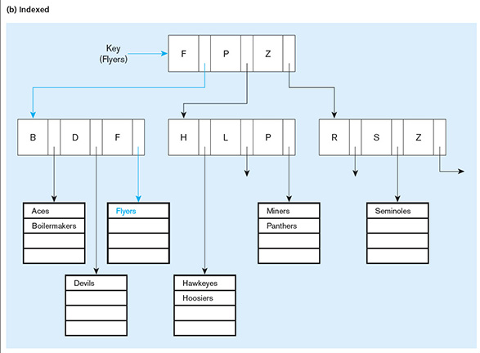
(b) Indexing

Slide 40
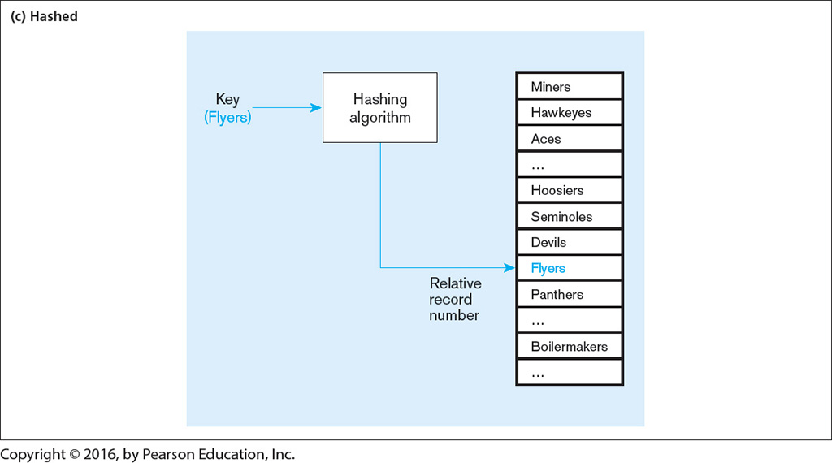
(c) Hashing

Slide 41
Index Classification
Primary vs. secondary: A primary index is an index on a set of fields that includes the primary key and is guaranteed not to contain duplicates. A secondary index is not a primary index (and may have duplicates).
Unique index: Search key contains a candidate key.
Clustered vs. unclustered: If the order of data records is the same as, or ‘close to’, order of data entries, then called clustered index.
A file can be clustered on at most one search key(s).
Cost of retrieving data records through index varies greatly based on whether the index is clustered or not!

Slide 42
Clustered vs. Unclustered Index
To build clustered index, first sort the Heap file (with some free space on each page for future inserts).
Overflow pages may be needed for inserts. (Thus, order of data recs is ‘close to’, but not identical to, the sort order.)
Index entries
direct search for data entries
Data entries
(Index File)
(Data file)
Data Records
Data Records
CLUSTERED
UNCLUSTERED

Slide 43
Clustered vs. Unclustered Index
A clustered index is one in which the ordering of data entries is the same as the ordering of data records. There can be at most one clustered index on a data file. An unclustered index is an index that is not clustered. There can be more than one unclustered index on a data file.

Slide 44
Hash-Based Indexes
Bucket Number
0
mod 4
1
Hash function
FIND
2
3
The modulo operation returns the remainder or signed remainder of a division. We will use the modulo operation to define a hash function.

Slide 45
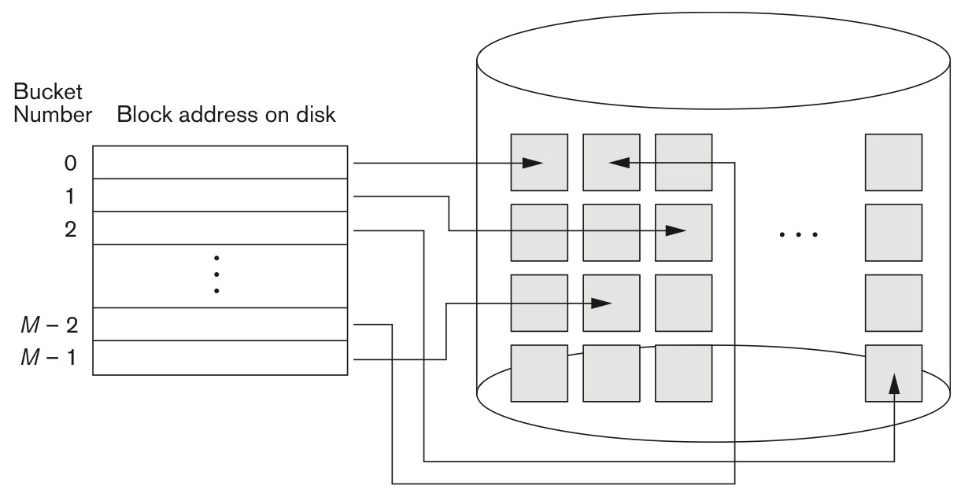
Hash-Based Indexes
Good for equality selections.
Index is a collection of buckets.
Bucket = primary page plus zero or more overflow pages.
Hashing function h: h(r) = bucket in which record r belongs. h looks at the search key fields of r.

Slide 46
Hashing
We consider two main hashing techniques.
Extendable Hashing
Linear Hashing

Slide 47
Extendable Hashing
An Extendible Hashing is a dynamic hashing method wherein directories (or bucket directories) and buckets are used to hash data.
The global depth determines the location of the bucket. If each directory entry points to one bucket, then the local depth should be equal to the global depth.
Global Depth d: array of 2^{d} bucket address.
Local Depth d ': the number of bits to find the record.
Note that Local Depth d '≤ Global depth d
The number of directory entries is equal to 2^{d.} Each bucket has associated with it a local depth denoted d'. If d' for the overflowed bucket is less than d, the global depth, then a new bucket is allocated.

Slide 48
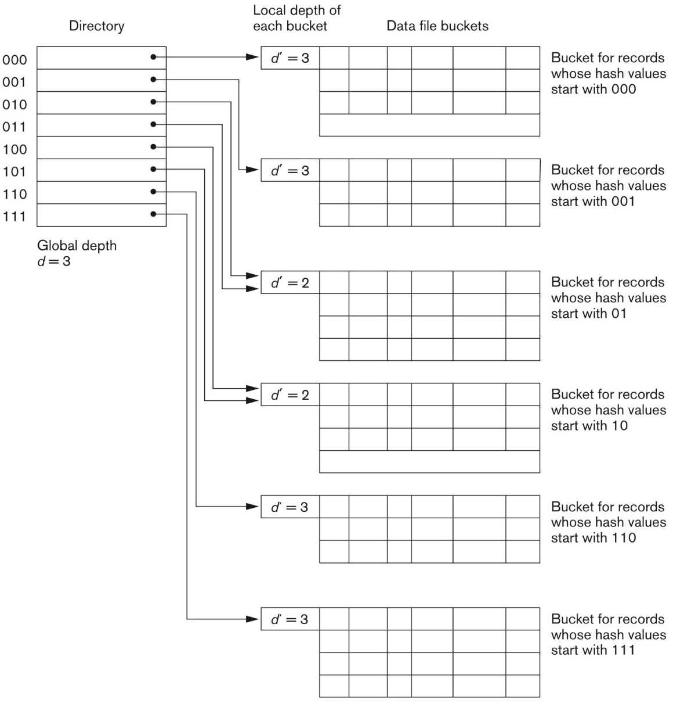
Extendable Hashing
Use a Directory to find a bucket
Global Depth
Local Depth

Slide 49
Extendable Hashing
1 | 000001
4 | 000100
5 | 000101
7 | 000111
10 | 001010
12 | 001100
15 | 001111
16 | 010000
19 | 010011
21 | 010101
32 | 100000
Insert { 1, 4, 5, 7, 10, 12, 15, 16, 19, 21, 32 }
Local Depth
Global Depth
(%4)
2
2
0
0
00
01
10
11
1
1
2
2
3
2
2
2
3

Slide 50
Extendable Hashing
1 | 000001
4 | 000100
5 | 000101
7 | 000111
10 | 001010
12 | 001100
15 | 001111
16 | 010000
19 | 010011
21 | 010101
32 | 100000
Insert { 1, 4, 5, 7, 10, 12, 15, 16, 19, 21, 32 }
Local Depth
Global Depth
(%4)
2
2
0
4 | 12 | 16 | 32
0
00
01
10
11
1
1
2
2
1 | 5 | 21
3
2
2
10
2
3
7 | 15 | 19

Slide 51
Extendable Hashing
1 | 000001
4 | 000100
5 | 000101
7 | 000111
10 | 001010
12 | 001100
13 | 001101
15 | 001111
16 | 010000
19 | 010011
21 | 010101
32 | 100000
Insert 13
Local Depth
Global Depth
(%4)
2
2
0
4 | 12 | 16 | 32
0
00
01
10
11
1
1
2
2
1 | 5 | 21
3
2
2
10
2
3
7 | 15 | 19

Slide 52
Extendable Hashing
1 | 000001
4 | 000100
5 | 000101
7 | 000111
10 | 001010
12 | 001100
13 | 001101
15 | 001111
16 | 010000
19 | 010011
21 | 010101
32 | 100000
Insert 13
Local Depth
Global Depth
(%4)
2
2
0
4 | 12 | 16 | 32
0
00
01
10
11
1
1
2
2
1 | 5 | 21 | 13
3
2
2
10
2
3
7 | 15 | 19

Slide 53
Extendable Hashing
1 | 000001
4 | 000100
5 | 000101
7 | 000111
10 | 001010
12 | 001100
13 | 001101
15 | 001111
16 | 010000
19 | 010011
20 | 010100
21 | 010101
32 | 100000
Insert 20
Local Depth
Global Depth
(%4)
2
2
0
4 | 12 | 16 | 32
0
00
01
10
11
1
1
2
2
1 | 5 | 21 | 13
3
2
2
10
2
3
7 | 15 | 19

Slide 54
Extendable Hashing
1 | 000001
4 | 000100
5 | 000101
7 | 000111
10 | 001010
12 | 001100
13 | 001101
15 | 001111
16 | 010000
19 | 010011
20 | 010100
21 | 010101
32 | 100000
Insert 20
Local Depth
Global Depth
(%8)
3
3
0
16 | 32
0
000
001
010
011
100
101
110
111
1
2
1,5
2
1 | 5 | 21 | 13
3
2,6
2
4
10
5
6
3,7
2
7
7 | 15 | 19
4
3
4 | 12 | 20

Slide 55
Extendable Hashing
1 | 000001
4 | 000100
5 | 000101
7 | 000111
9 | 001001
10 | 001010
12 | 001100
13 | 001101
15 | 001111
16 | 010000
19 | 010011
20 | 010100
21 | 010101
32 | 100000
Insert 9
Local Depth
Global Depth
(%8)
3
3
0
16 | 32
0
000
001
010
011
100
101
110
111
1
2
1,5
2
1 | 5 | 21 | 13
3
2,6
2
4
10
5
6
3,7
2
7
7 | 15 | 19
4
3
4 | 12 | 20

Slide 56
Extendable Hashing
1 | 000001
4 | 000100
5 | 000101
7 | 000111
9 | 001001
10 | 001010
12 | 001100
13 | 001101
15 | 001111
16 | 010000
19 | 010011
20 | 010100
21 | 010101
32 | 100000
Insert 9
Local Depth
Global Depth
(%8)
3
3
0
16 | 32
0
000
001
010
011
100
101
110
111
1
3
1
1 | 9
2
3
2
2,6
10
4
5
2
3,7
7 | 15 | 19
6
7
3
4
4 | 12 | 20
5
3
5 | 13 | 21

Slide 57
Extendable Hashing
Use a Directory of Points to buckets.
Global and local Depth
Data insertion may trigger a split.
A bucket split increases the local depth.
If a bucket whose local depth is equal to the global depth and the bucket is split, then the directory must be doubled.

Slide 58
Linear Hashing
Linear Hashing
Linear Hashing is a dynamically updateable disk-based index structure that implements a hash table and grows or shrinks one bucket at a time. The index is used to support exact match queries, i.e., find the record with a given key.
In order to access a record with key k, a family of hash functions, h₀, h₁, h₂,…, is applied to the key k.
A family of hash functions (e.g., h₀, h₁, h₂,…)
Round-Robin Fashion
Overflow pages

Slide 59
Linear Hashing
The bucket to be split is chosen in a round-robin fashion.
The linear hashing algorithm performs splits in a round-robin fashion, rather than splitting at a bucket that overflowed. The splits are performed in linear order (bucket 0 first, then bucket 1, then 2, ...), and a split is performed when any bucket overflows.
Current round number is Next.
Buckets 0 to Next-1 have been split.
We will use the modulo operation to define a family of hash functions
h₀ = x % 2², h₁ = x % 2³, h₂ = x % 2⁴, …

Slide 60
Linear Hashing
Insert {5, 7, 9, 10, 11, 14, 18, 25, 30, 31, 32, 35, 36, 44}
Next Point
(%8)
(%4)
h1
h0
Primary Page
Overflow Page
000
00
001
01
010
10
011
11

Slide 61
Linear Hashing
Insert {5, 7, 9, 10, 11, 14, 18, 25, 30, 31, 32, 35, 36, 44}
Next Point
(%8)
(%4)
h1
h0
Primary Page
Overflow Page
000
00
32 | 36 | 44
001
01
5 | 9 | 25
010
10
10 | 14 | 18 | 30
011
11
7 | 11 | 31 | 35

Slide 62
Linear Hashing
Insert 43
Next Point
(%8)
(%4)
h1
h0
Primary Page
Overflow Page
000
00
32 | 36 | 44
001
01
5 | 9 | 25
010
10
10 | 14 | 18 | 30
011
11
7 | 11 | 31 | 35

Slide 63
Linear Hashing
Insert 43
(%8)
(%4)
h1
h0
Primary Page
Overflow Page
000
00
32 | 36 | 44
Split !!
001
01
5 | 9 | 25
Next Point
010
10
10 | 14 | 18 | 30
011
11
7 | 11 | 31 | 35
43
100
00

Slide 64
Linear Hashing
Insert 43
(%8)
(%4)
h1
h0
Primary Page
Overflow Page
000
00
32
Split !!
001
01
5 | 9 | 25
Next Point
010
10
10 | 14 | 18 | 30
011
11
7 | 11 | 31 | 35
43
100
00
36 | 44

Slide 65
Linear Hashing
Insert 37
(%8)
(%4)
h1
h0
Primary Page
Overflow Page
000
00
32
001
01
5 | 9 | 25
Next Point
010
10
10 | 14 | 18 | 30
011
11
7 | 11 | 31 | 35
43
100
00
36 | 44

Slide 66
Linear Hashing
Insert 37
(%8)
(%4)
h1
h0
Primary Page
Overflow Page
000
00
32
001
01
5 | 9 | 25 | 37
Next Point
010
10
10 | 14 | 18 | 30
011
11
7 | 11 | 31 | 35
43
100
00
36 | 44

Slide 67
Linear Hashing
Insert 29
(%8)
(%4)
h1
h0
Primary Page
Overflow Page
000
00
32
Next Point
001
01
5 | 9 | 25 | 37
010
10
10 | 14 | 18 | 30
011
11
7 | 11 | 31 | 35
43
100
00
36 | 44

Slide 68
Linear Hashing
Insert 29
(%8)
(%4)
h1
h0
Primary Page
Overflow Page
000
00
32
001
01
5 | 9 | 25 | 37
29
Split !!
010
10
10 | 14 | 18 | 30
Next Point
011
11
7 | 11 | 31 | 35
43
100
00
36 | 44
101
01

Slide 69
Linear Hashing
Insert 29
(%8)
(%4)
h1
h0
Primary Page
Overflow Page
000
00
32
001
01
9 | 25
010
10
10 | 14 | 18 | 30
Next Point
011
11
7 | 11 | 31 | 35
43
100
00
36 | 44
101
01
5 | 29 | 37

Slide 70
Linear Hashing
Insert 22
(%8)
(%4)
h1
h0
Primary Page
Overflow Page
000
00
32
001
01
9 | 25
Next Point
010
10
10 | 14 | 18 | 30
011
11
7 | 11 | 31 | 35
43
100
00
36 | 44
101
01
5 | 29 | 37

Slide 71
Linear Hashing
Insert 22
(%8)
(%4)
h1
h0
Primary Page
Overflow Page
000
00
32
001
01
9 | 25
010
10
10 | 14 | 18 | 30
22
011
11
7 | 11 | 31 | 35
43
100
00
36 | 44
101
01
5 | 29 | 37
110
10

Slide 72
Linear Hashing
Insert 22
(%8)
(%4)
h1
h0
Primary Page
Overflow Page
000
00
32
001
01
9 | 25
010
10
10 | 18
011
11
7 | 11 | 31 | 35
43
100
00
36 | 44
101
01
5 | 29 | 37
110
10
14 | 22 | 30

Slide 73
Linear Hashing
Insert 66
(%8)
(%4)
h1
h0
Primary Page
Overflow Page
000
00
32
001
01
9 | 25
010
10
10 | 18
011
11
7 | 11 | 31 | 35
43
100
00
36 | 44
101
01
5 | 29 | 37
110
10
14 | 22 | 30

Slide 74
Linear Hashing
Insert 66
(%8)
(%4)
h1
h0
Primary Page
Overflow Page
000
00
32
001
01
9 | 25
010
10
10 | 18 | 66
011
11
7 | 11 | 31 | 35
43
100
00
36 | 44
101
01
5 | 29 | 37
110
10
14 | 22 | 30

Slide 75
Linear Hashing
Insert 34
(%8)
(%4)
h1
h0
Primary Page
Overflow Page
000
00
32
001
01
9 | 25
010
10
10 | 18 | 66
011
11
7 | 11 | 31 | 35
43
100
00
36 | 44
101
01
5 | 29 | 37
110
10
14 | 22 | 30

Slide 76
Linear Hashing
Insert 34
(%8)
(%4)
h1
h0
Primary Page
Overflow Page
000
00
32
001
01
9 | 25
010
10
10 | 18 | 66 | 34
011
11
7 | 11 | 31 | 35
43
100
00
36 | 44
101
01
5 | 29 | 37
110
10
14 | 22 | 30

Slide 77
Linear Hashing
Insert 50
(%8)
(%4)
h1
h0
Primary Page
Overflow Page
000
00
32
001
01
9 | 25
010
10
10 | 18 | 66 | 34
011
11
7 | 11 | 31 | 35
43
100
00
36 | 44
101
01
5 | 29 | 37
110
10
14 | 22 | 30

Slide 78
Linear Hashing
Insert 50
(%8)
(%4)
h1
h0
Primary Page
Overflow Page
000
00
32
001
01
9 | 25
010
10
10 | 18 | 66 | 34
50
011
11
11 | 35 | 43
100
00
36 | 44
101
01
5 | 29 | 37
110
10
14 | 22 | 30
111
11
7 | 31

Slide 79
Linear Hashing
Linear Hashing uses overflow pages and splits buckets in a round-robin fashion.
A family of hash functions (i.e., h_{level,} h_{level+1, …}) is used for identifying the location of the bucket.
Skewed data distribution causes a long overflow chain.

Slide 80
Take home message
Block, Blocking Factor, Record
RAID
File Organization
Heap
Sorted File
Hashing Techniques
Extendable Hashing
Linear Hashing

